Slide 1
GLOBAL ELECTRONICS RETAILER
Sales & Business Performance Analysis
A Data Analytics Project
Tools Used: Python | SQL | Excel | Power BI
Presented by: Nomula Vishal
Role: Aspiring Data Analyst

Slide 2
Project Overview
Global Electronics Retailer is a multinational electronics business selling products across different markets and currencies.
The business generates large volumes of sales data, which can be used to understand revenue performance, profitability, customer behavior, and store efficiency.
Business Problem
How sales and profitability change over time.
Which products and categories contribute the most revenue.
Which customers make repeat purchases.
Which markets and stores perform well.
Where business improvement opportunities may exist.

Slide 3
Dataset Description
The project uses the Global Electronics Retailer dataset containing sales transactions and supporting business information.
Data Set | Description
Sales | Transaction-level sales information
Customers | Customer demographics and location
Products | Product names, brands, categories, costs, and prices
Stores | Store locations and physical details
Exchange Rates | Currency exchange information
Data Dictionary | Description of dataset fields
Dataset Statistics
Sales line items: 62,884
Distinct orders: 26,326
Customer master records: 15,266
Product master records: 2,517
Store master records: 67
Data period: 2016-01-01- 2021-02-20

Slide 4
Data Preparation Process
Raw Data → Data Inspection → Data Cleaning → Validation → Analysis
Data Quality
Inspected missing values and duplicate records.
Reviewed column names and data types.
Converted date fields into appropriate formats.
Converted currency and numeric fields into usable numeric values.
Validated key relationships between Sales and dimension tables.
Feature Engineering
Created Revenue.
Created Unit Cost and Total Cost fields.
Created Profit and Profit Margin.
Derived Customer Age from date of birth.
Created Customer Age Group buckets.
Created Delivery Delays
Derived Store Age from Store open date
Created Age Group buckets

Slide 5




Tools & Analytical Approach
End-to-end retail data analytics workflow
Data Cleaning & Preparation
Data inspection
Missing value and duplicate checks
Data type conversion
Feature engineering
Output: Cleaned and prepared dataset
Business Analysis
Data querying
Joins and aggregations
53 business questions
Revenue and Profitability analysis
Output: Business insights from SQL analysis
Reporting
KPI summaries
Pivot Tables
Pivot Charts
Excel dashboard
Output: Analytics reports and summaries
Visualization
DAX measures
Interactive dashboards
Data visualizations
Filters and Slicers
Output: Interactive business reports

Slide 6
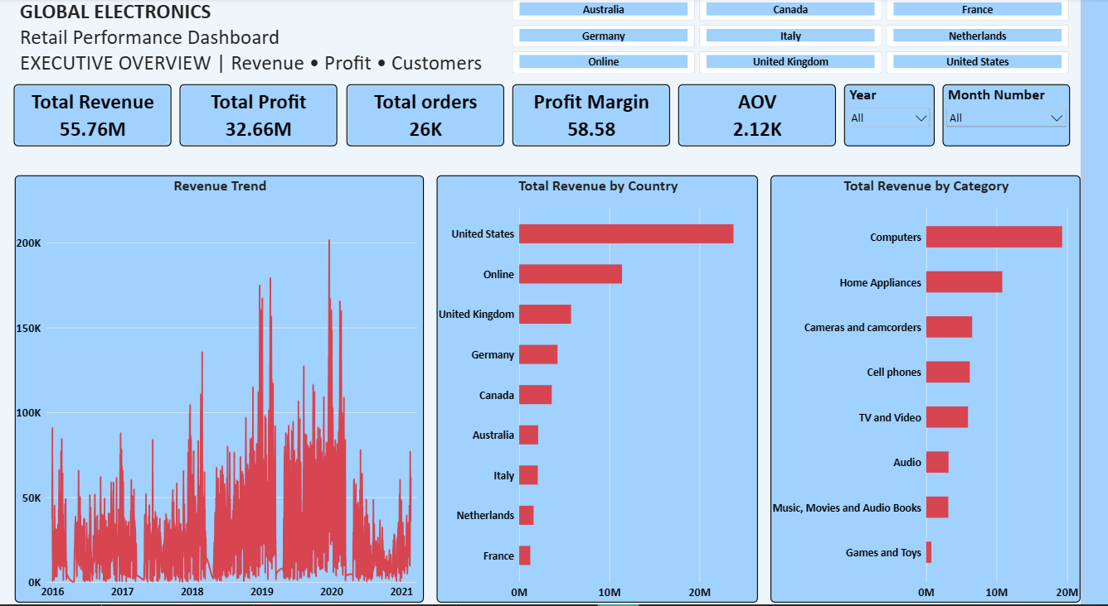
Overall business performance

Slide 7
Revenue Trend Analysis
Key Findings
Revenue increased from 2016 through 2019.
2019 was the highest-revenue year.
Revenue in 2020 was lower than in 2019.
2021 contains only partial-year data.

Slide 8
Product Performance Analysis
The analysis focused on identifying the products and categories that contribute the most revenue and profit.
Key Findings
Computers contributed approximately 34.62% of total revenue.
Home Appliances contributed approximately 19.36% of total revenue.
Cameras and camcorders contributed approximately 11.69%.
The highest-revenue individual product was WWI Desktop PC2.33 X2330 Black.
Top 10 products generated approximately $4.30M in revenue.

Slide 9
Customer Purchasing Behaviour
Key Findings
47.64% of all customers are repeat customers.
30.23% of customers made only one purchase.
22.13% of customer master records have no recorded orders.
Repeat customers account for 82.47% of distinct orders.

Slide 10
Market Performance
Key Findings
The United States was the largest physical market by revenue.
Online sales generated approximately $11.40M.
The United Kingdom was the second-largest physical market.
Store performance can be evaluated using revenue and, where available, revenue per square meter.
Stores aged 6-10 years contribute the highest revenue share (57.26%)
Stores aged 11-15 years contribute the lowest revenue share (10.40%)

Slide 11
Key Business Insights & Recommendations
Turning data into actionable business opportunities
Strategic Recommendations
Monitor computer product demand, inventory and profitability.
Strengthen customer retention and loyalty initiatives.
Investigate the 2019 revenue peak and subsequent decline.
Explore conversion opportunities among customers without recorded orders.
Monitor online sales and profitability separately.
PRODUCTS
34.62%
Computers revenue contribution
Largest revenue-generating category.
CUSTOMERS
82.47%
Orders from repeat customers
Repeat purchases account for most orders.
SALES TREND
$18.26M
2019 revenue peak
Revenue was lower in 2020.
CUSTOMER BASE
3,379
Customers without recorded orders
Potential customer conversion opportunity.
MARKET
$11.40M
Online revenue contribution
Online is an important sales channel that deserves separate performance monitoring.

Slide 12
Project Conclusion
End-to-end Retail Data Analytics Project
Project Highlights
Cleaned and prepared retail data using Python.
Performed 53 business analysis questions using SQL.
Created KPI summaries, PivotTables, and dashboards using Excel.
Developed interactive dashboards using Power BI.
Identified business trends and opportunities across products, customers, markets, and stores.
Thank You!
Questions & Discussion
Overall Outcome
Transformed raw retail data into meaningful business insights and actionable recommendations to support data-driven decision-making.

